Slide 1
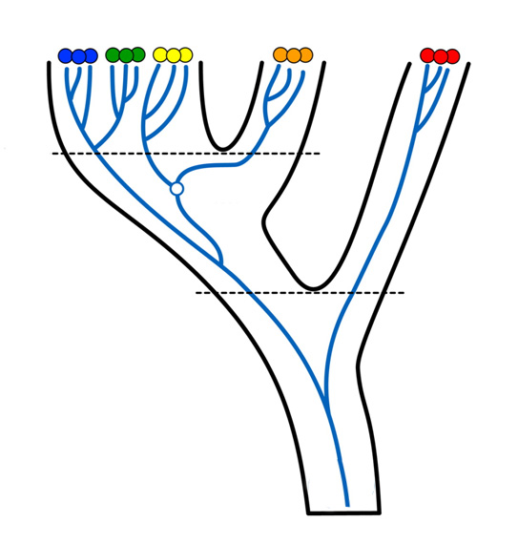
DNA-based species delimitation
Frederik Leliaert
Olivier De Clerck

Slide 2
Content
Use of DNA in evolutionary and ecological studies
Species concept
Delineating species using DNA

Slide 3

Applications of molecular techniques
DNA
  Every living organism contains DNA
  Every organism is characterized by a unique DNA signature
  Through common descent DNA of closely of related organisms will be more similar than that of distantly related organisms

Slide 4
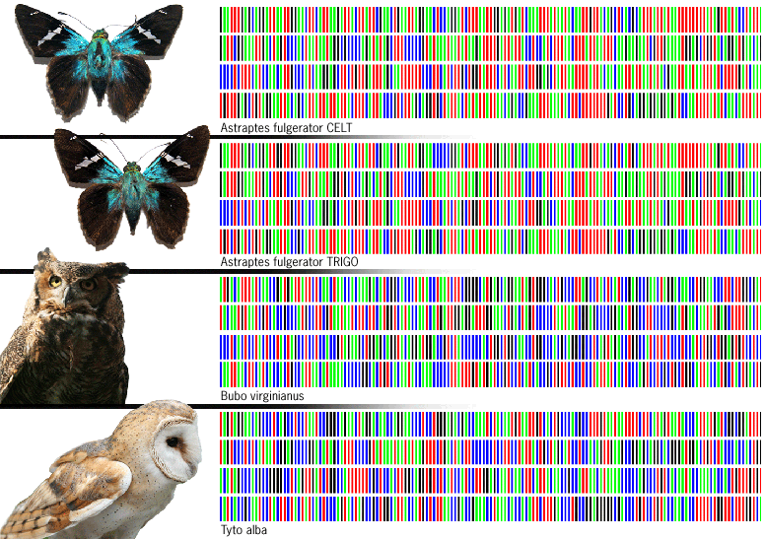

Applications of molecular techniques
DNA to identify organisms
  “barcode”
  fast – accurate

Slide 5
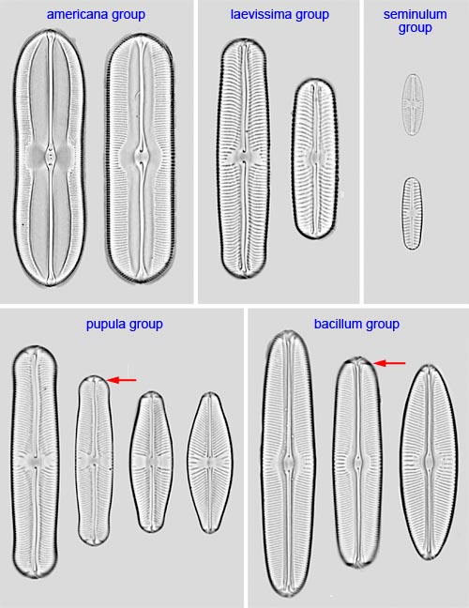
Applications of molecular techniques
DNA to identify organisms
  circumvents cryptic diversity
  prominent in morphologically ‘simple’ organisms
←[coccolithophores]
[Sellaphora diatoms] →

Slide 6
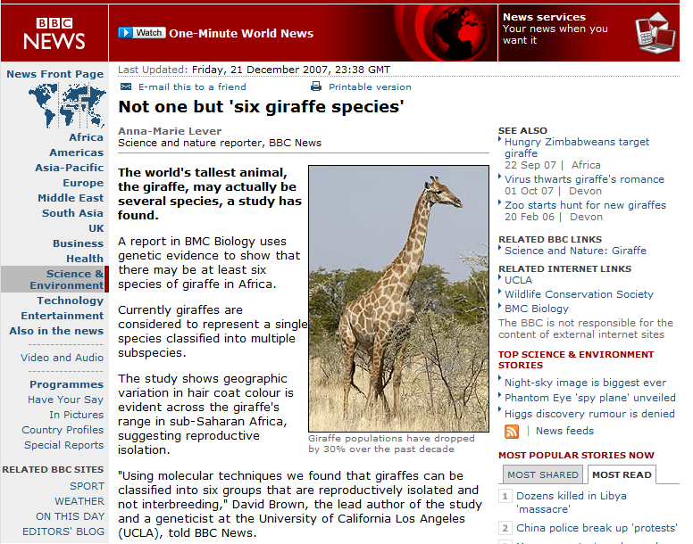
Applications of molecular techniques

Slide 7
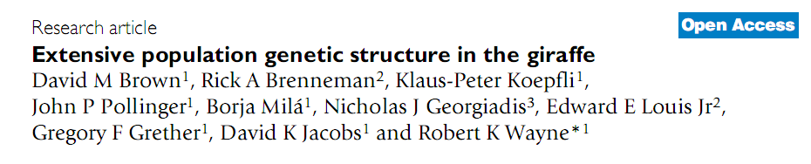
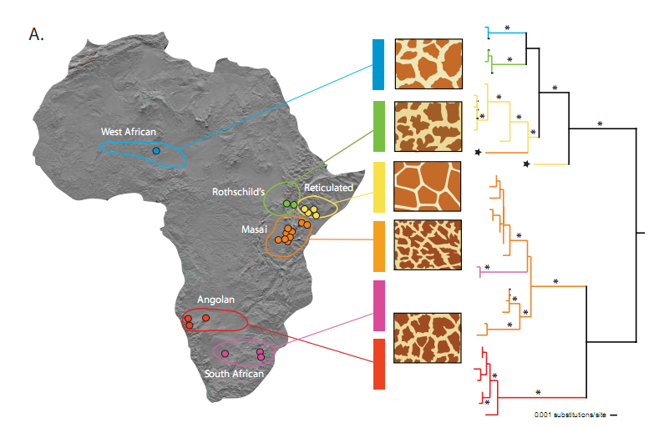
Applications of molecular techniques

Slide 8
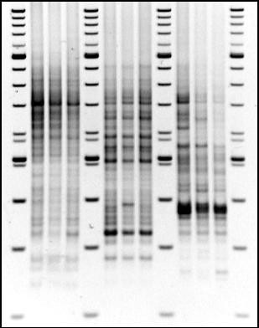

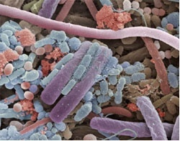
Applications of molecular techniques
DNA to identify organisms
  circumvents non-culturable diveristy
    e.g. microbial communties
[black smokers]
[bacteria TEM]
[DGGE gel]

Slide 9
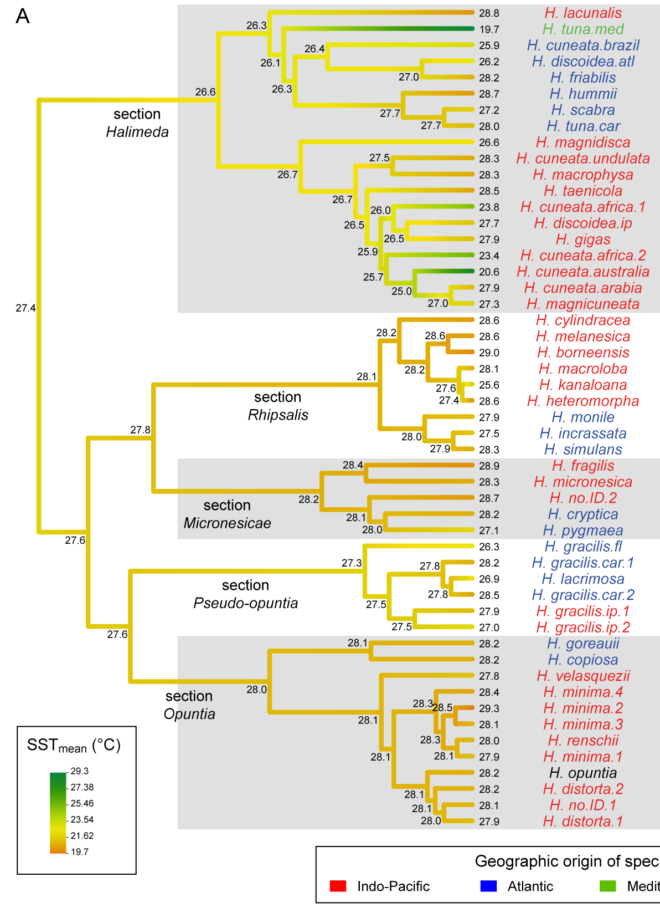
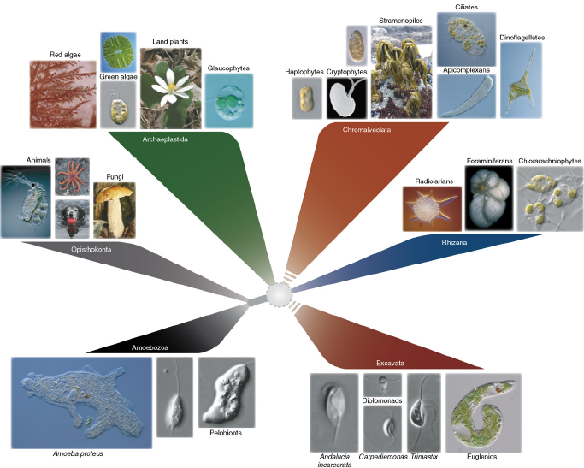
Applications of molecular techniques
DNA to identify relationships
  from ancient relationships …
  … to populations

Slide 10
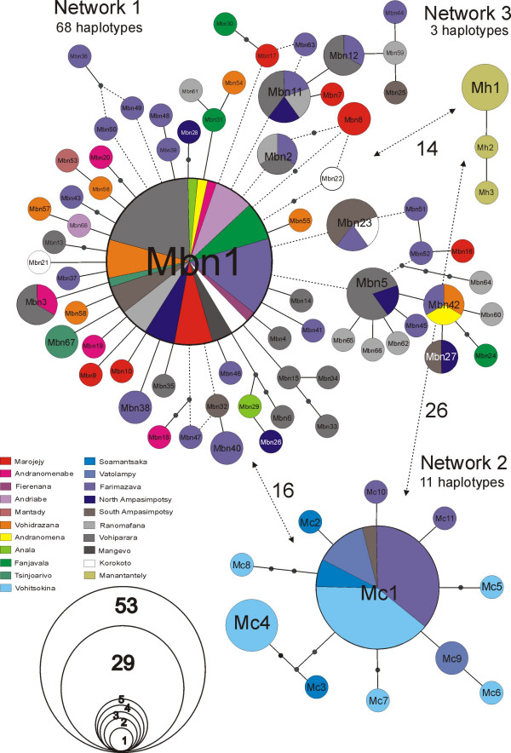
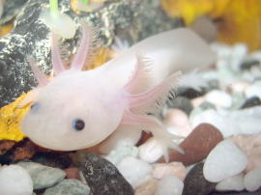
Applications of molecular techniques
DNA to identify relationships
  from ancient relationships …
  … to populations

Slide 11

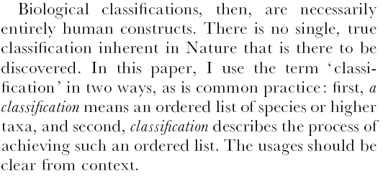
Delineating species
Higher taxonomic ranks are human constructs
Species are real (more or less)
[Benton 2000]

Slide 12
Delineating species
What is a species ?
The simpler the question, the more difficult the answer …
Alternatively, the answer is difficult because the question is flawed
It is surprisingly difficult to define the word "species" in a way that applies to all naturally occurring organisms, and the debate among biologists about how to define "species" and how to identify actual species is called the species problem.
Ernst Mayr's biological species concept: a species comprises all the individual organisms of a natural population that generally interbreed at maturity in the wild and whose interbreeding produces fertile offspring.

Slide 13
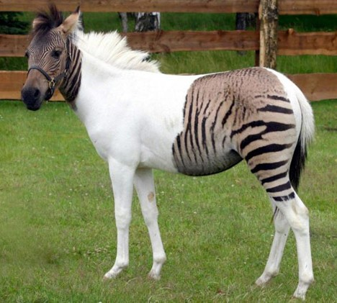
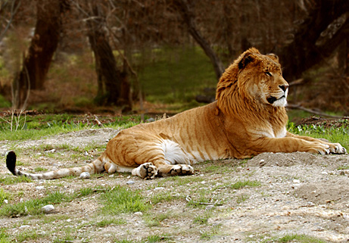
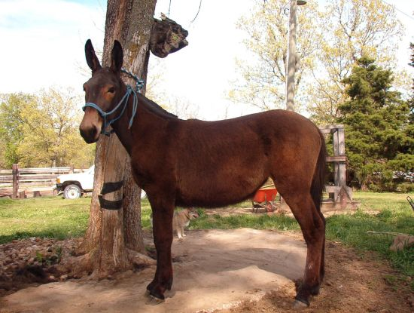
Delineating species
What is a species ?
Ernst Mayr's biological species concept: a species comprises all the individual organisms of a natural population that generally interbreed at maturity in the wild and whose interbreeding produces fertile offspring.

Slide 14
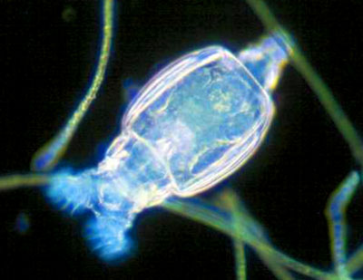
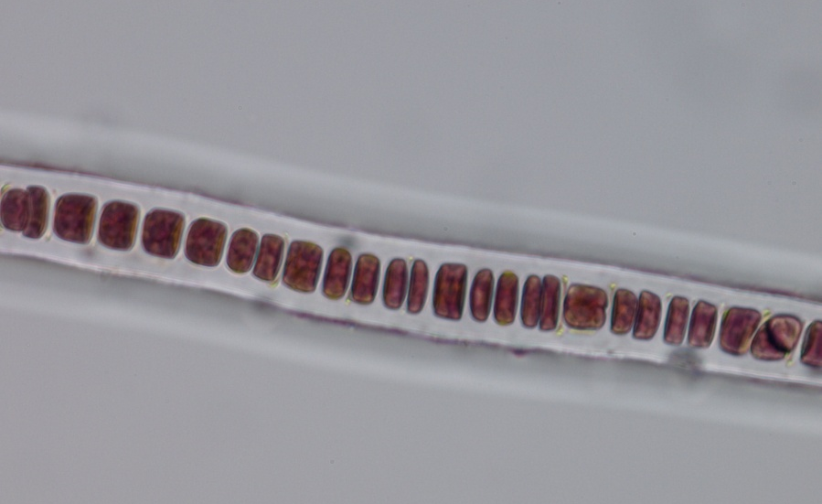
Delineating species
Problems with the biological species concept:
  only works for sexual organisms
  ignorance about the capability of morphologically similar groups of organisms to "potentially" interbreeding in nature
Bdelloid rotifers
Some red algae Stylonema

Slide 15
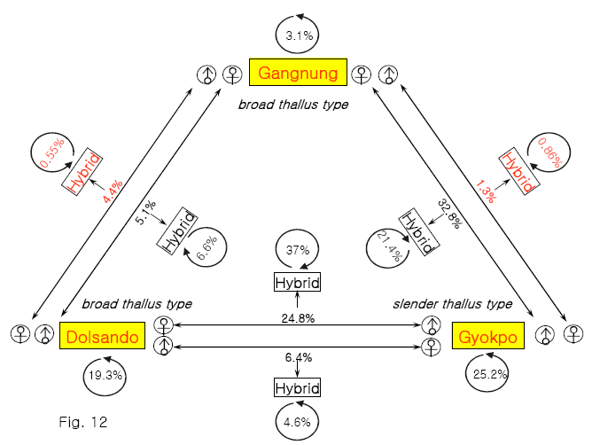
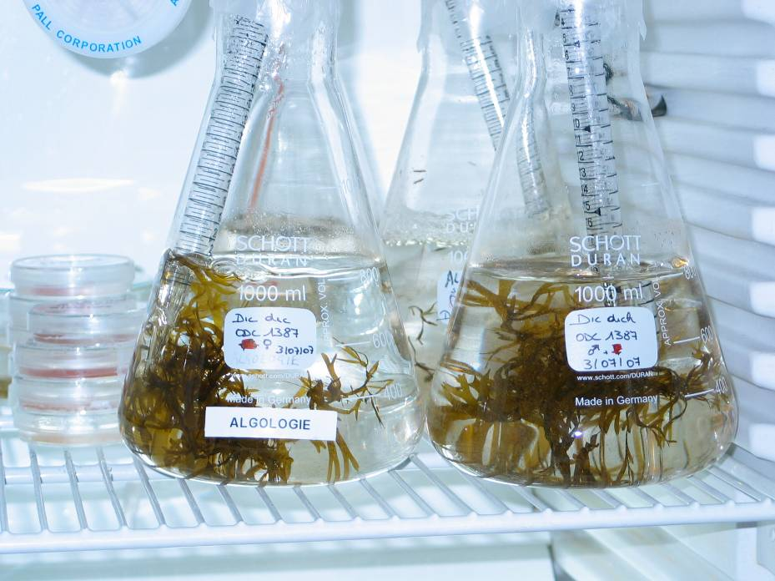
Delineating species
Problems with the biological species concept:
  reproductive isolation is a continuous character
  a matter of degree rather than presence/absence

Slide 16

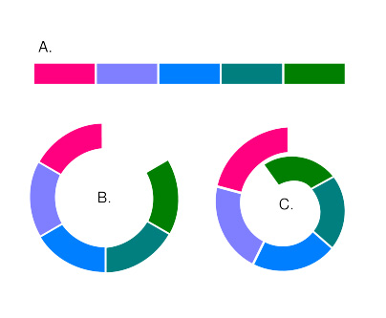
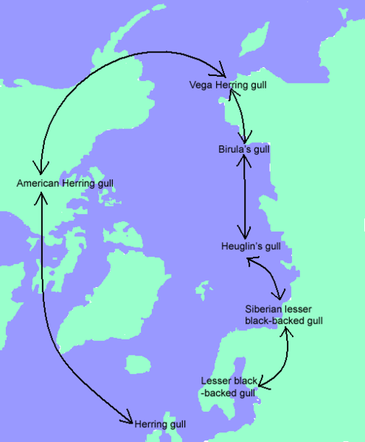
Delineating species
Problems with the biological species concept:
  how to deal with ring species?
Larus

Slide 17
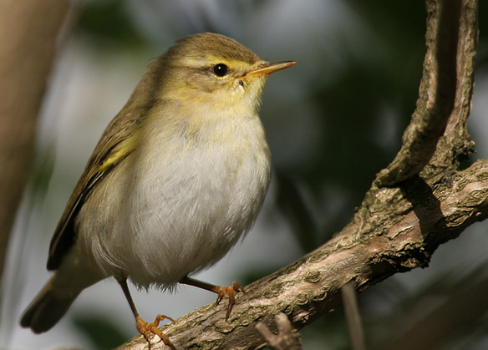
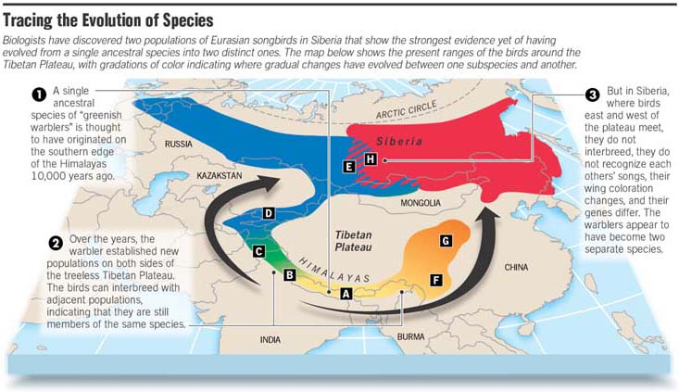
Delineating species
Problems with the biological species concept:
  how to deal with ring species?
Phylloscopus trochilus
Notes:
fitis

Slide 18
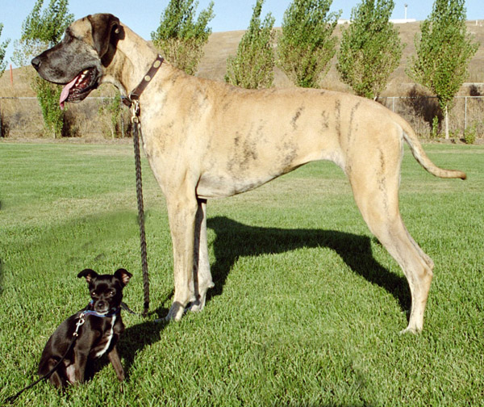
Delineating species
Problems with the biological species concept:
  physical constraints ?

Slide 19
Delineating species
What is a species ?
The simpler the question, the more difficult the answer …
Alternatively, the answer is difficult because the question is flawed
Proliferation of species concepts

Slide 20
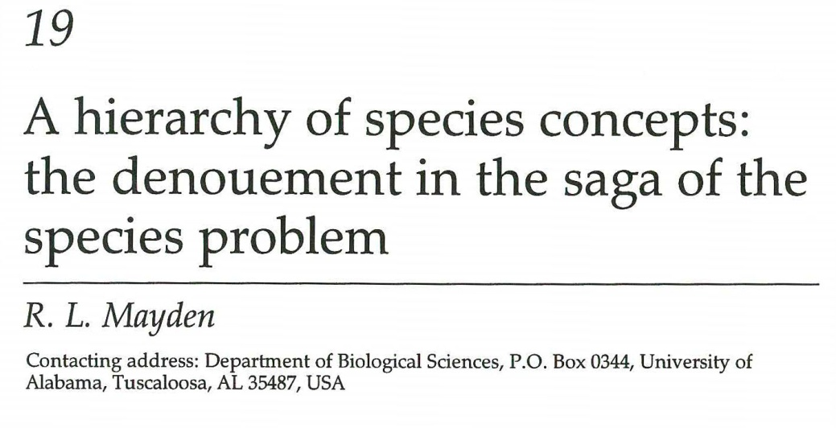
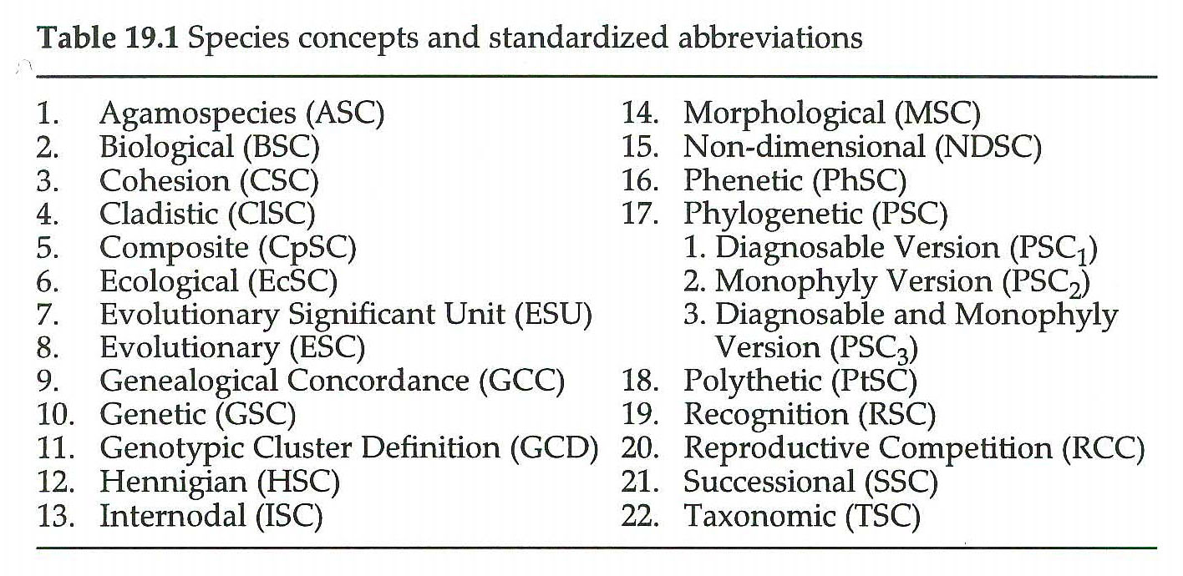
Delineating species
What is a species ?
Proliferation of species concepts

Slide 21
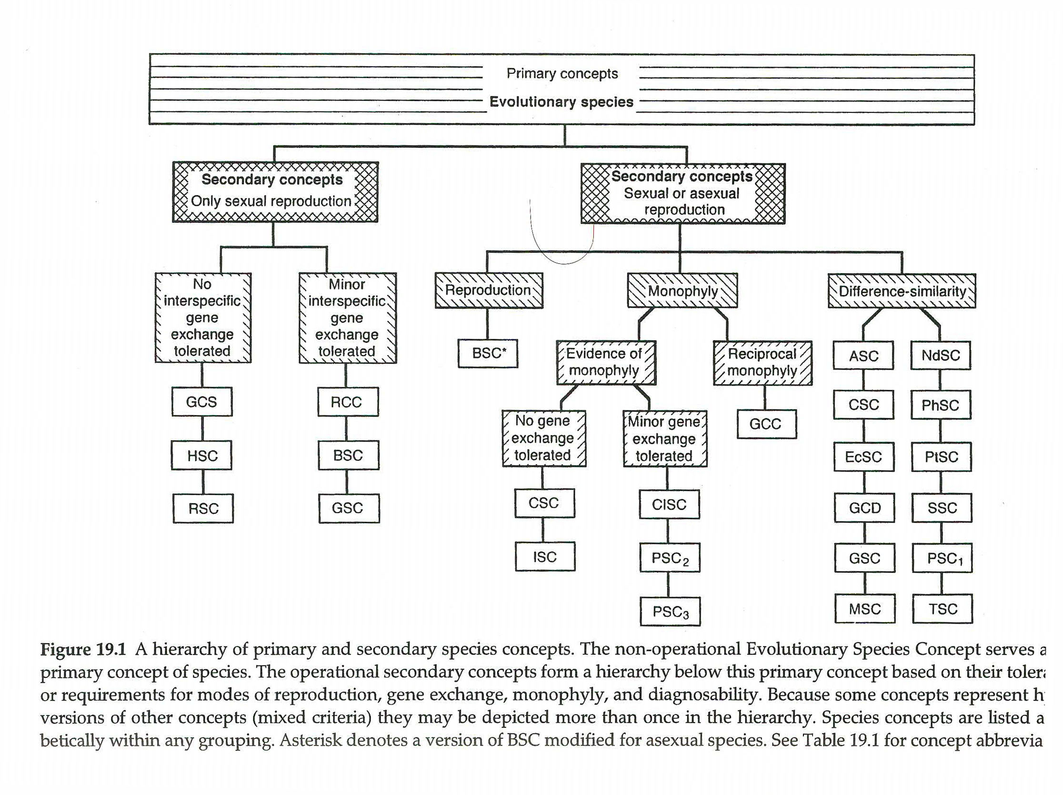
Delineating species

Slide 22
Delineating species
What is a species ?
The general lineage concept
[De Queiroz 2007]

Slide 23
Barcoding species
If species are real and we agree on the ‘general lineage concept’ how can we delineate them ?
The Barcoding option
  The value: quick & dirty
    easy (even machines can do it)
    cheap (compared to the salary of taxonomist)
    fast (96-well plate takes 2 hours to sequence)
  The drawback:
  • you pay for simplicity in the long run
    ignorance about speciation

Slide 24
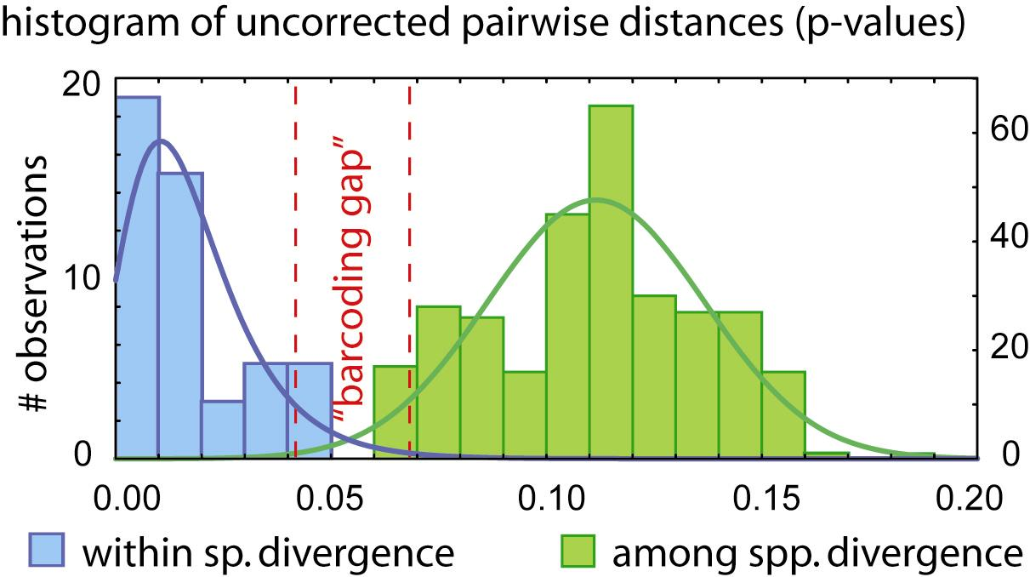
Barcoding species
The central tenet in barcoding

Slide 25
Barcoding species
The central tenet in barcoding

Slide 26
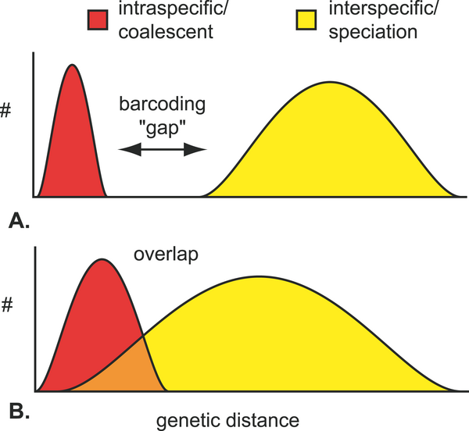
Barcoding species
The central tenet in barcoding
Does a barcoding gap equals different species ?
and vice versa ?
How does sampling affect the gap ?

Slide 27
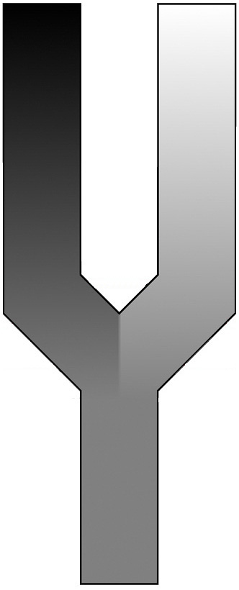
Beyond the barcoding gap - a more realistic view on speciation
separately evolving metapopulation lineages
Time
selection/
drift
selection/
drift
Barrier to gene flow
ancestral species
Notes:
Speciation results from isolation of populations by a barrier to gene flow.
This barrier results in selection and drift that are acting independently, resulting in separately evolving metapopulation lineages.

Slide 28
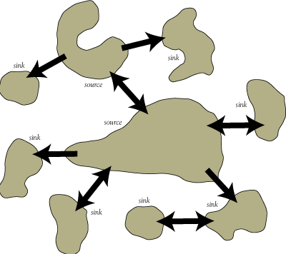
species =
separately evolving metapopulation lineage
Metapopulation = a group of spatially separated populations that are connected at some level
Notes:
Metapopulation = a group of spatially separated populations which are connected at some level.
In other word the spatially separate populations, which are each characterized by high levels of gene flow are connected to each other by some degree of dispersal or gene flow.

Slide 29
species =
separately evolving metapopulation lineage
Metapopulation extended through time
time
Notes:
The term lineage refers to the fact that a species is not restricted to a single point in time but it consists of a metapopulation that extents through time

Slide 30
species =
separately evolving metapopulation lineages
time
Barrier to gene flow

Slide 31
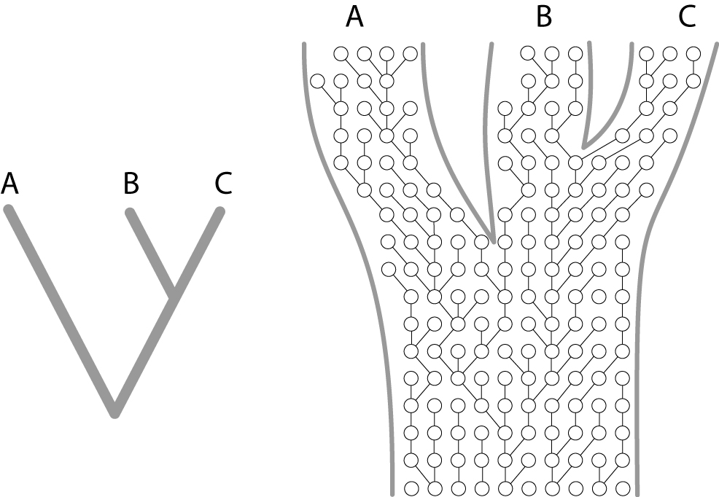
Phylogeny at the level of populations and species
Species are metapopulation lineages > new methods for DNA-based species delimitation
Genes: variable > informative below & above species level
Gene trees
Vital to understanding the process of speciation
Span intraspecific and interspecific evolution
A
B
C
A
B
C
>>
(Wright-Fisher process)
Species phylogeny
Population genetics:
coalescence process
Notes:
The idea that species are metapopulation lineages has led to the development of new DNA-base species delimitation methods.
Genes that show variation within species will be phylogenetically informative below and above the species level.
Gene trees are vital to understanding the process of speciation because they span intraspecific and interspecific evolution.
When we think about a phylogeny, we typically think about species relationships in a tree. But within the branches of this tree there is population genetics going on, which can be modeled as a coalescence process.

Slide 32
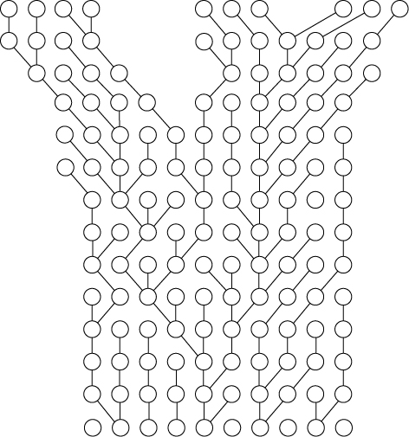
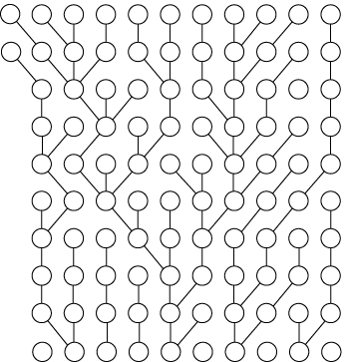


Phylogeny at the level of populations and species
Barriers to gene flow
coalescence process
: individual organisms / allele copy
Notes:
This is how the process runs:
Each circle may represent an individual organism, but in this case it represents an allele copy of a specific gene.
You start out with a set of allele copies in the first generation.
Then you create the next generation by selecting copies from the first generation at random
For the next generation you do the same, but this time you sample from the second generation
… and so on. This is how the process runs within a population or species.
When populations become separated by a barrier to gene flow, you can sample allele copies only from individuals within the same population, ...

Slide 33
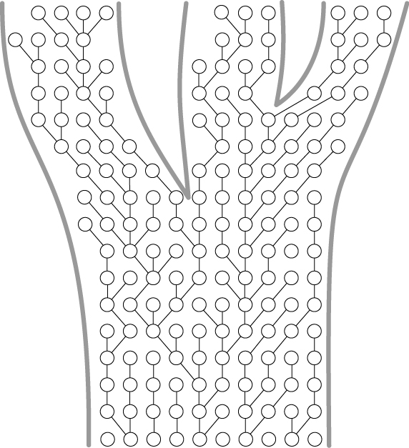
Phylogeny at the level of populations and species
separately evolving metapopulation lineages
A
B
C
Time
T2
T1
Notes:
... and this well eventually result in separately evolving metapopulation lineages
So this figure illustrates two speciation events at time T1 and T2.
This process, running inside the species tree, has two consequences: …

Slide 34
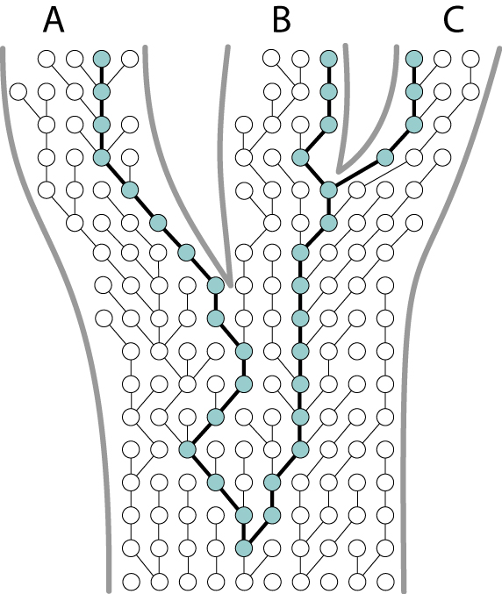
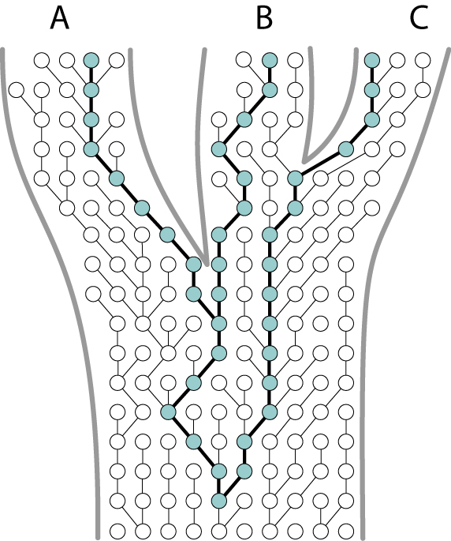
Phylogeny at the level of populations and species
A
B
C
A
B
C
T2
T1
= MRCA
deep coalescence
incomplete lineage sorting
Notes:
First, DNA divergence times may not correspond to speciation times. In this example, the most recent common ancestor (MRCA) of these three alleles is more ancient than the first speciation event. This is known as “deep coalescence”.
Secondly, the topology of the gene tree can be different from the species tree. This is a direct consequence of this deep coalescence, in combination with incomplete fixation of gene lineages within species lineages, known as incomplete lineage sorting. So in this example, the gene tree would wrongly suggest a closer relationship between species A and B

Slide 35
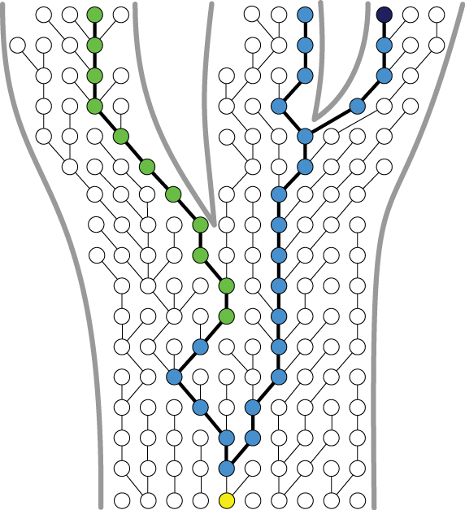
Phylogeny at the level of populations and species
A
B
C
time
Notes:
Gene trees can only be analysed when mutations have occured along the way, resulting in different alleles (indicated here with different colours). So here we have a yellow allele, which mutated resulting in a blue allele, and so on ...

Slide 36
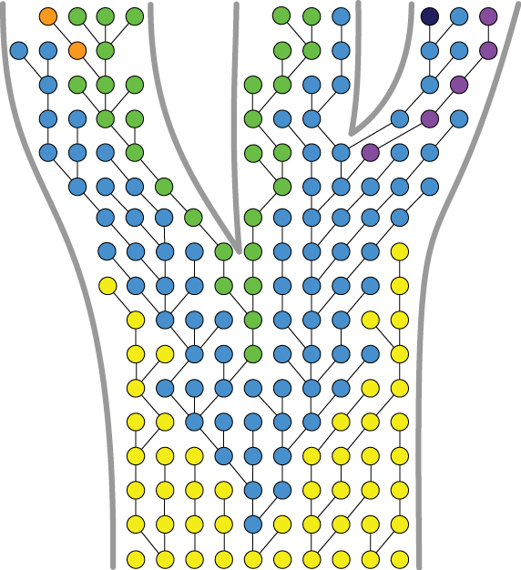
Phylogeny at the level of populations and species
A
B
C
Trans-species polymorphism
Notes:
When we colour the entire figure, we can see two important things:
- First we see that in the course of time allele frequencies will change within one species, and that in some cases alleles will be lost alltogether. For example in this case the yellow allele was initially dominant and was gradually lost in time and replaced by the blue allele.
- Secondly, when new species are formed, newly formed species will largely contain ancestral alleles. As a result identical alleles are shared between different species, known as trans-species polymorphism. For example, initially all three newly formed species contained the dominant blue allele. In present time, the “green” alleles are shared between species A&B, and the “blue” alleles between species B&C.

Slide 37
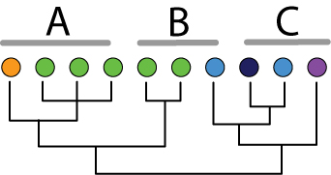
Phylogeny at the level of populations and species
A
B
C
>>
Trans-species polymorphism
3 species:
Not reciprocally monophyletic
Notes:
When we would construct a gene tree at this stage, we would find that early diverging species are not necessarily monophyletic in their alleles at a studied locus.
In this case species C is paraphyletic because it includes all descendant alleles from this common ancestor here, except for this blue one here.
Species B is polyphyletic because for one set of alleles it shares a common ancestor with species A, while the other alleles are more closely related to species C.
- Species A is in principle monophyletic because it contains all the descendant alleles of a common ancestral allele from the same species. However, in practice, a phylogenetic analysis might not recover species A as monophyletic as it shares the green alleles with species B.

Slide 38
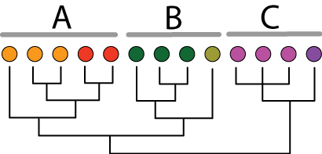
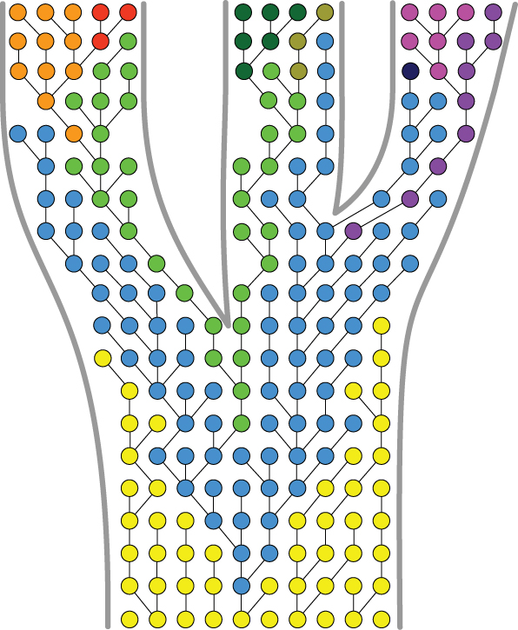
Phylogeny at the level of populations and species
A
B
C
Reciprocal monophyly
>>
Fixation of alleles
3 species:
Reciprocally monophyletic
Notes:
As time goes by, alleles will become fixed in the species, which will result in reciprocal monophyly. The relationships between the alleles of a studies locus will correspond to the species.
So in this example, species A, B and C are monophyletic because in each species the alleles share a single common ancestor, which

Slide 39
Phylogeny at the level of populations and species
A
B
C
Gene genealogies below and above the species level are different in nature
Young lineages reside within a zone where both processes meet
species delimitation
population genetics
phylogenetics
>>
Notes:
Now what this figure shows is that although gene genealogies below and above the species level are different in nature, young lineages reside within a zone where both processes meet.
Therefore species delimitation should incorporate aspects of both population genetics and phylogenetics.

Slide 40
DNA-based species delimitation
Notes:
Several methods of DNA-based species delimitation have been developed.
I will focus on two recently developed methods that combine phylogenetic and coalescent models: one single-locus and one multi-locus approach

Slide 41
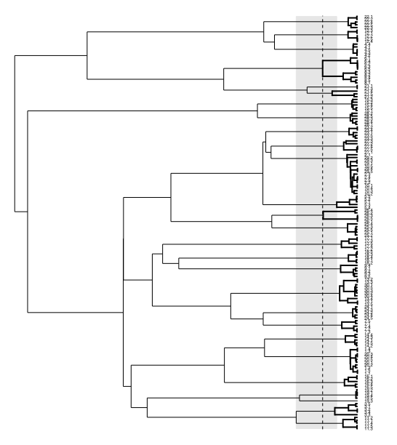
GMYC-model approach
Likelihood method
Single locus DNA data
Species-level (speciation & extinction) & population-level (coalescence) evolutionary processes
Different branching rates
[Pons, Barraclough et al. 2006,
Monaghan et al. 2009]
Notes:
A first method, the GMYC model approach, is a likelihood method that uses single-locus data.
The idea is that differences between species-level evolutionary processes (speciation and selection) and population-level evolutionary processes will result in different branching rates in a phylogenetic tree.
The approach aims at detecting this shift between interspecific and intraspecific branching.

Slide 42
GMYC-model approach
Between species branching
Within species
branching
Raw data
Branching rates on ultrametric tree
(e.g. relaxed mol. clock tree)
Statistical approach (LRT)
Null model: No separate lineages
Alternative model: Separately evolving lineages
Location of switch from speciation
to coalescent nodes
Statistical measure of confidence
Software: SPLITS package for R: http:// r-forge.r-project.org/projects/splits
Neutral coalescent model
General Mixed Yule Coalescent (GMYC) model
[Pons et al. 2006,
Monaghan et al. 2009]
Notes:
The approach uses branching rates on an ultrametric tree as raw data.
First two alternative models are compared to test if there is evidence for a transition in branching rates:
1) A single coalescence model that assumes no separate lineages
2) and a model that combines a coalescent model of intraspecific branching with a Yule model for interspecific branching, thus assuming multiple species.
Next, the location of the switch from speciation to coalescence nodes is fitted on the tree (this vertical line), resulting in an estimation of species boundaries.
Finally, the method provides a statistical measure of confidence for the species boundaries (indicated with this light grey bar here).

Slide 43
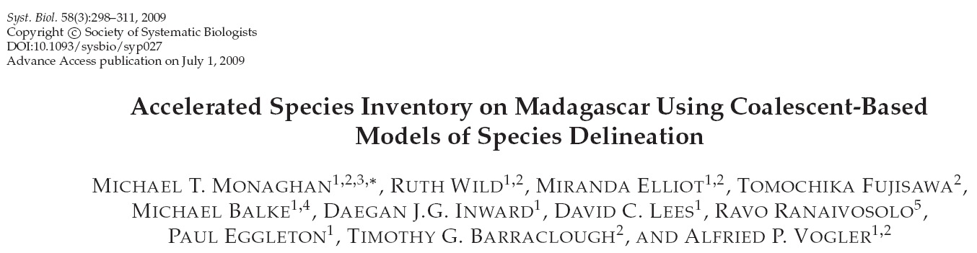
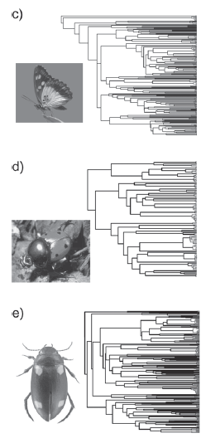
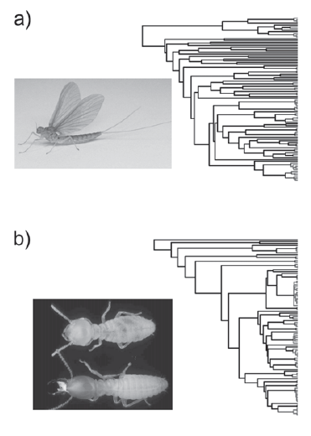
Notes:
This approach has been found useful for rapid species inventory and discovery.
For example in this study the mitochondrial cox2 gene was sequenced for more than 1500 insects in Madagascar, resulting in the recognition of 370 putative species.

Slide 44
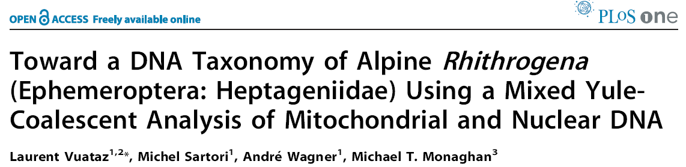
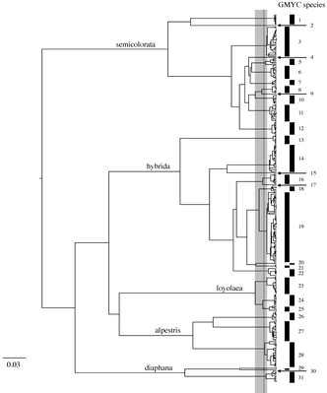
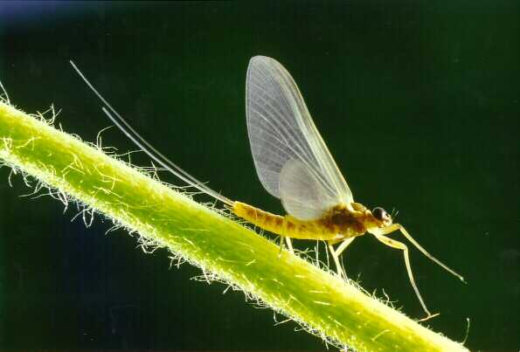
Notes:
mayfly genus Rhithrogena

Slide 45






“Boodlea composita”
“Boodlea composita”
“Phyllodictyon anastomosans”
“Cladophoropsis vaucheriiformis”
Notes:
[skip slide]
More or less the same story in the Boodlea complex, where we analysed the ITS region.
Like in Bryopsis, a combination of cryptic diversity and intraspecific morphological variability resulted in serious conflict with traditional species boundaries.

Slide 46






Dictyota
184 psbA sequences
logL_{GMYC} = 1672 > logL_{nul} = 1649, p < 0.001
39 (34-43) GMYC clusters
Dictyota crenulata
Dictyota ciliolata
[Tronholm et al. unpublished]
Notes:
This is the brown alga Dictyota.
Here we focussed specifically on two species with a wide geographical distribution: Dicyota crenulata and D. ciliolata.
We analysed plastid encoded psbA sequences, and found that Dictyota crenulata actually consists of several cryptic species with more restricted distributions. In contrast, the pantropical distribution of D. ciliolata is confirmed by DNA data.
The wide range of D. ciliolata can best be explained by its tolerance towards low temperatures, which would have allowed it to disperse over cold water barriers like southern Africa.

Slide 47

Multi-locus methods
A
B
C
Monophyly
Paraphyly
Polyphyly
[Avise 2000]
Notes:
Now, let’s go back to this figure, which shows that after lineage splitting, species will go through a phase of polyphyly and paraphyly before becoming monophyletic.
This means that reciprocal monophyly cannot be regarded as a necessary property of species, especially in young lineages.
Simulation studies indicate that a large amount of time is required after initial divergence of a species before there will be a high probability of observing monophyly. This probability is a function of effective population size. So for example, for two lineages with effective population sizes of half a million and one generation a year, it could take about 2 million years before they would be recognized as species under a reciprocal monophyly criterion.

Slide 48

Multi-locus methods
species tree – gene tree discordance
Early stages of speciation
Retention of ancestral polymorphism
Incomplete lineage sorting
→ different loci have their own gene trees that do not necessarily match the species tree
Species tree
Gene trees of 6 different loci
[Knowles & Carstens 2007]
Notes:
Especially at early stages of speciation, retention of ancestral polymorphism and incomplete lineage sorting will result in different loci having their own gene trees that do not necessarily match the species tree

Slide 49
Multi-locus methods
New species delimitation methods
  Multi-locus data
  Models combining
    Species phylogenies
    Coalescent processes
Software
  BP&P [Yang & Rannala 2010]:
  http://abacus.gene.ucl.ac.uk/
  BROWNIE [O’Meara 2010]:
  http://www.brianomeara.info/brownie
  SpedeSTEM [Ence & Carstens 2011]
  Species delimitation – Geneious plugin [Masters, Fan & Ross 2010]
  http://www.biomatters.com
Despite the lack of monophyletic species, a signal of species divergence persists in gene trees of unlinked loci
Notes:
New methods of species delimitation are being developed that use multi-locus data and models combining species phylogenies and coalescent processes.
The idea is that despite the lack of monophyletic species, a signal of species divergence persists in gene trees of unlinked loci.
These methods are still at an early stage of development, but some have already been implemented in software packages, listed here.

Slide 50

Multi-locus Bayesian species delimitation
  Bayesian method (BP&P)
  Multilocus sequence data
  User-specified species tree
  Prior information:
    population size (Θ)
    divergence times (τ₀)
  Reversible-jump Markov chain Monte Carlo (rjMCMC): estimates posterior distribution for species delimitation models
[Yang & Rannala 2010]
Notes:
Finally we used a recently developed Bayesian method, BP&P by Yang & Rannala 2010, which uses multilocus sequence data, a user-supplied species tree, and prior information on population sizes and divergence times.
The process of species delimitation can be seen as a choice among possible sets of species on a tree structure. The method uses reversible jump Markov chain Monte Carlo to estimate posterior distribution for species delimitation models.

Slide 51




Notes:
Genealogical data are an important source of evidence for delimiting species, yet few statistical methods are available for calculating the probabilities associated with different species delimitations. Bayesian species delimitation uses reversible-jump Markov chain Monte Carlo (rjMCMC) in conjunction with a user-specified guide tree to estimate the posterior distribution for species delimitation models containing different numbers of species. We apply Bayesian species delimitation to investigate the speciation history of forest geckos (Hemidactylus fasciatus) from tropicalWest Africa using five nuclear loci (and mtDNA) for 51 specimens representing 10 populations.We find that species diversity in H. fasciatus is currently underestimated, and describe three new species to reflect the most conservative estimate for the number of species in this complex. We examine the impact of the guide tree, and the prior distributions on ancestral population sizes (u) and root age (t0), on the posterior probabilities for species delimitation. Mis-specification of the guide tree or the prior distribution for u can result in strong support for models containing more species. We describe a new statistic for summarizing the posterior distribution of species delimitation models, called speciation probabilities, which summarize the posterior support for each speciation event on the starting guide tree.

Slide 52


Portieria
P. hornemannii
P. spinulosa
P. japonica
P. tripinnata
P. harveyii
Wiseman (1973):
P. hornemannii
[Payo et al. unpublished]
Notes:
We used a multi-locus approach to study species diversity within the red seaweed Portieria.
Portieria is widespread in the tropical and subtropical Indo-West Pacific, and although several species have been described, most phycologists now recognize a single polymorphic species, Portieria hornemanii.

Slide 53



Portieria: GMYC analysis
Philippines: 265 cox 2-3 spacer sequences
logL_{GMYC} = 462.92 > logL_{nul} = 449.25, p < 0.001
21 (19-24) GMYC clusters
[Payo et al. unpublished]
Notes:
As a first step, we analyzed a large number of mitochondrial cox2-3 spacer sequences from the Philippines. A GMYC analysis of this dataset resulted in about 21 putative species.

Slide 54

Portieria: gene trees
cox 2-3 spacer
EF2
rbcL + spacer
[Payo et al. unpublished]
Notes:
Next we generated datasets of two additional loci: the nuclear EF2 and the plastid rbcL+spacer.
What we found is that most cox2-3 GMYC clusters were also recovered as monophyletic groups in the nuclear and plastid tree.
Except in this clade here, we found incongruence. This blue clade, for example, is poly- or paraphyletic in the two other trees. Similarly, the red, green and purple clusters were not recovered as clades in the EF tree.

Slide 55


Portieria: Multi-locus Bayesian species delimitation
  Species tree: *BEAST (cox / EF / rbcL)
  Bayesian species delimitation: BP&P
  3 prior combinations
    large pop size / deep div.
    small pop size / shallow div.
    large pop size / shallow div.
21 cryptic Portieria species in the Philippines
[Payo et al. unpublished]
Notes:
For Portieria, we ran the multi-locus Bayesian analysis with different priors, including the conservative combination of large population size and shallow divergences, which would favor fewer species.
When assuming 21 species, the analysis showed high speciation probabilities for all nodes (indicated with the green boxes), thus confirming the species boundaries based on the cox 2-3 dataset.
In order to verify whether the GMYC analysis might have underestimated species diversity, we reran the analysis including more pre-defined species, but these subdivided nodes were clearly not supported by the analysis.
So, in conclusion, we feel confident that there are at least 21 cryptic Portieria species in the Philippines.
Unveiling cryptic diversity in algae doesn’t come as a surprise, but the degree here is quite spectacular.

Slide 56
Conclusions
Notes:
In conclusion, new methods of species delimitation show the increased importance of combining population genetic with phylogenetic methods.
Speciation is a continuous process so DNA-based species delimitation should be accompanied by some degree of uncertainty. Newly proposed methods are probabilistic tests for species boundaries that provide statistical support and a level of uncertainty.
Finally, and this links to the next talk, our analysis confirm that because of their fast coalescence, plastid and mitochondrial markers are very effective in detecting species boundaries and are useful for large scale analyses of species diversity.

Slide 57
Further reading
Avise JC, Wollenberg K. 1997. Phylogenetics and the origin of species. Proceedings of the National Academy of Sciences. 94:7748-7755.
Sites JW, Marshall JC. 2003. Delimiting species: a Renaissance issue in systematic biology. Trends in Ecology & Evolution. 18:462-470.
De Queiroz K. 2007. Species concepts and species delimitation. Systematic Biology. 56:879-886
Knowles LL, Carstens BC. 2007. Delimiting Species without Monophyletic Gene Trees. Systematic Biology. 56:887-895.
Degnan JH, Rosenberg NA. 2009. Gene tree discordance, phylogenetic inference and the multispecies coalescent. Trends in Ecology & Evolution. 24:332-340.
Kuhner MK. 2009. Coalescent genealogy samplers: windows into population history. Trends in Ecology & Evolution. 24:86-93.
Yang Z, Rannala B. 2010. Bayesian species delimitation using multilocus sequence data. Proceedings of the National Academy of Sciences. 107:9264-9269.
Leaché AD, Fujita MK. 2010. Bayesian species delimitation in West African forest geckos (Hemidactylus fasciatus). Proceedings of the Royal Society B: Biological Sciences. 277:3071-3077.

