Slide 1
Cuvierian tubules Fonction - Structure -Variation

Slide 2
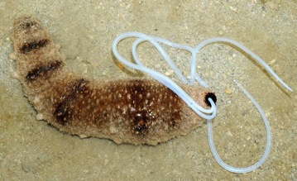
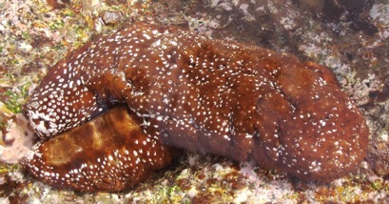
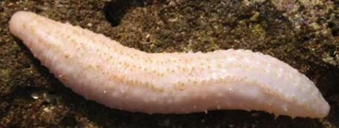
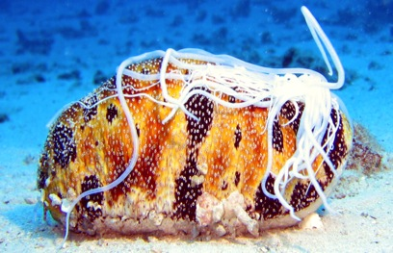
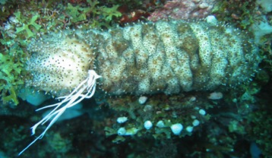
Cuvierian tubules – where?
These unique structure are only found in
some species of Aspidochirotida,
more precisely in the genera:
Holothuria
Actinopyga
Labidodemas
Bohadschia
Pearsonothuria

Slide 3
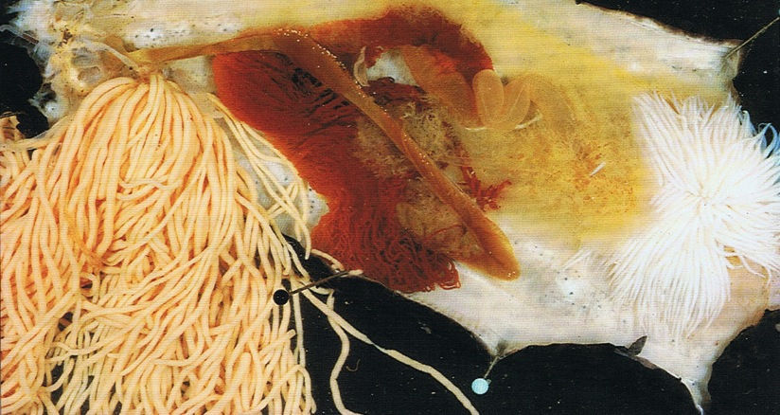
What are the Cuvierian tubules ?
They are intracoelomic caeca that generally occur in great number (up to 600) and attacht to the basal part of the left respiratory tree.
Gut
Ring
Ct
Gonad
Rete mirabile
Left respiratory tree

Slide 4
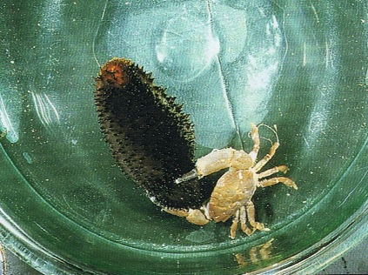
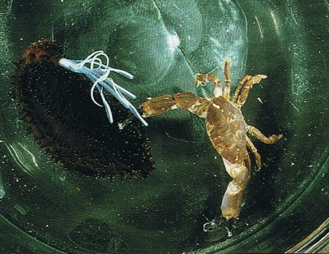
What is the function of the Cuvierian tubules ?
Cuvierian tubules are defensive organes.
Irritated, the holothuroids expel them through the anus

Slide 5
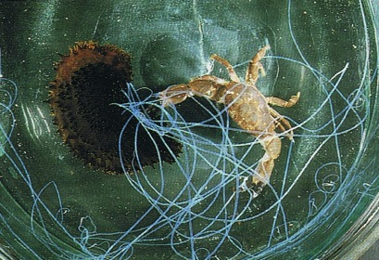
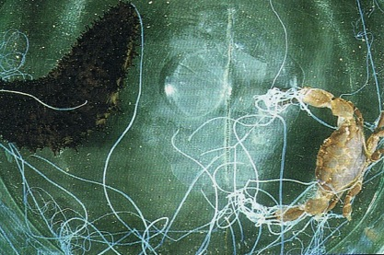
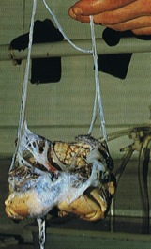
What is the function of the Cuvierian tubules ?
The expelled tubules lengthen, become sticky and rapidly immobilize most organisms with which they come in contact!
Quiescent tubules are not sticky.
The elongated tubules do not adhere to mucus-cover surfaces, thus preventing them from sticking to the holothuroid body.

Slide 6
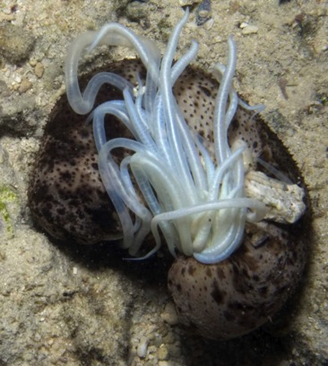
How do Cuvierian tubules elongate?
Expelled tubules are always in the process of elongation.
Tubules elongate gradually from their basal extremity.
Tubules elongation is irreversible and considerable (up to 20 times their original length!).
Elongating tubules become progressively translucent while their diameter remains unchanged.
Elongation results from powerful entry of water into the tubule

Slide 7
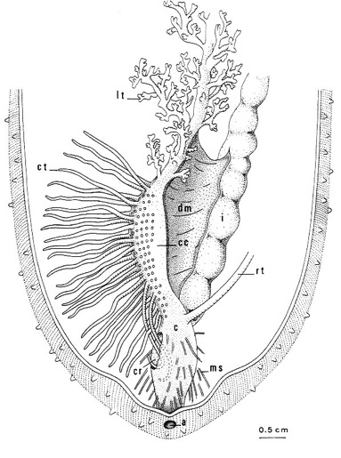
How it works?
The injection of water in the CT is as follow:
Individuals completely contract their respiratory trees, expelling the water content in the cloaca.
Part of the water expelled by the left respiratory tree enters the lumen of some tubules, causing their elongation.
During contraction of the individuals, the hydrostatic pressure of the coelomic fluid increases and the opening of the anus causes cloacal rupture and tubules expulsion.
Both tubules elongation and expulsion are basically caused by the contraction of the body wall which increases the pressure of the internal fluids.

Slide 8
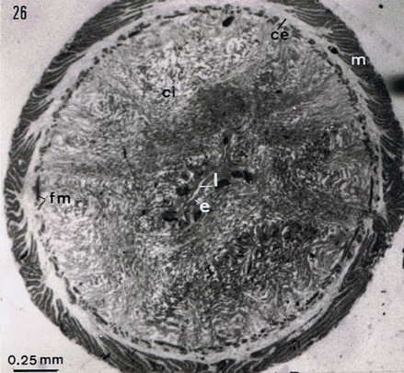
Why do tubules lengthen?
From the inside to the outside, the tubules consist of:
a mesothelium lining the surface of the tubule that is exposed to the coelomic cavity.
a thick connective tissue layer
an inner epithelium surrounding the narrow lumen

Slide 9
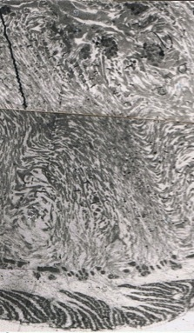
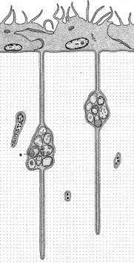
The inner epithelium
The lumen of the tubule is lined by a highly convoluted epithelium.
The basal part of epithelial cells consist of one to three elongated process penetrating deeply in the connective tissue.
The basal process contains piles of 5 to 25 spherules; the content of each spherule is released in the tubule lumen during elongation and could give the rigidity to an elongated tubule.

Slide 10
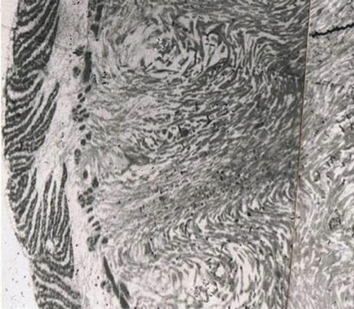
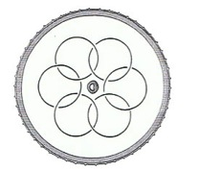
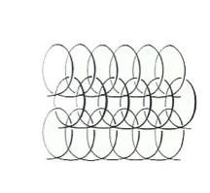
The connective tissue
The connective tissue forms 90% of the tubule’s thickness and encloses up to six imbricated collagen helices, each of them being parallel to the long axis of the tubule.
*
*
It also includes longitudinal and circular muscle fibers

Slide 11
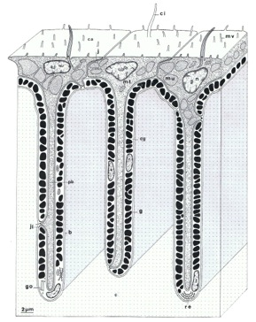
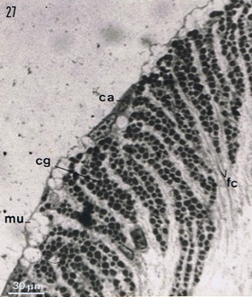
The mesothelium
The mesothelium is the tissue layer responsible for adhesion.
It is a pseudostratified epithelium made up of two superposed cell layers:
an outer layer of adluminal cells
an inner layer of granular cells which is highly folded along the long axis of the tubule.
Granular cells are filled with densely packed granules enclosing the substance responsible of adhesion.

Slide 12
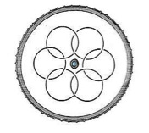
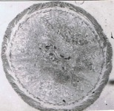
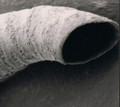
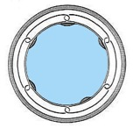
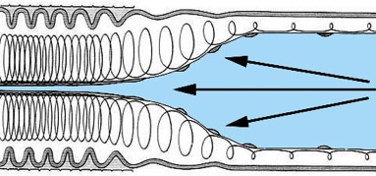
Quiescent tubules - elongated tubules
During elongation, the structure of the Cuvierian tubule is modified
The inner epithelium is dissociated,
The helices of collagen fibers in the connective tissue layer are stretched,
The protective outer layer of the mesothelium disintegrates
The granular cell layer, now unfolded, becomes outermost on the tubule.

Slide 13
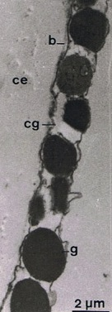
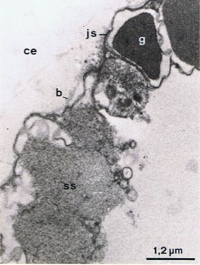
Adhesion
Granular cells empty the contents of their granules only when the elongated tubule comes into contact with a surface, resulting in adhesion
The adhesion of Cuvierian tubules is remarkable in several respects:
adhesion occurs in water
adhesion is achieved in a matter of
seconds (less than 10 sec)
adhesion remains active during
several hours
Paradoxically, the exact nature of the
adhesive is still unknown!
Without contact
With contact
(More information in Flammang et al 2002)

Slide 14
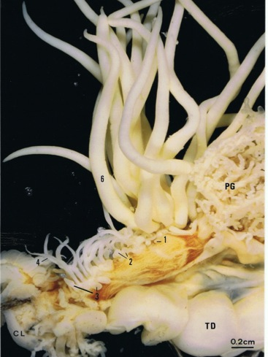
Maintaining the line of Defense
Expelled tubules autotomize at their attachment point on the left respiratory tree and are left behind as the holothuroid crawls away.
As only a portion of the tubules are emitted at one time, the total number may suffice for several responses.
After expulsion, the lost tubules are readily regenerated, making them a formidable defense mechanism.
(More information in VandenSpiegel et al 2000)

Slide 15
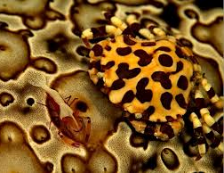
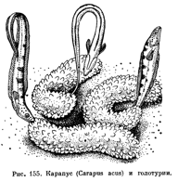
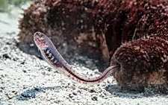
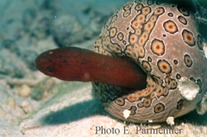
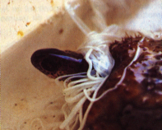
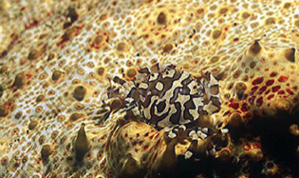
Cuvierian tubules and symbiosis
Cuvierian tubules have no effect on different symbionts of sea cucumber
Some sea cucumbers are used as shelter to a fish known as the pearl fish which lives inside their respiratory tree during the day and emerges at night to feed.
Lissocarcinus orbicularis, an obligate symbiont of sea cucumbers

Slide 16
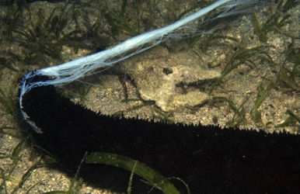
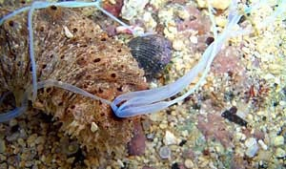
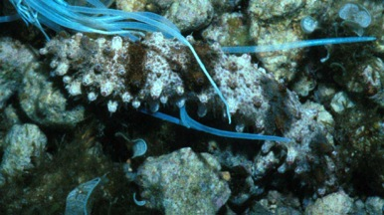
Variation
All functional Cuvierian tubules (i.e. the expelled ones) investigated so far have almost the same structure.
Holothuria

Slide 17
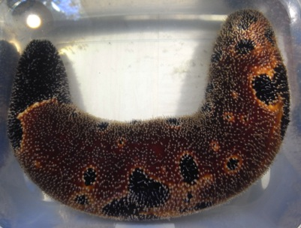
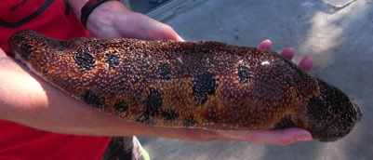
Variation
Bohadschia

Slide 18
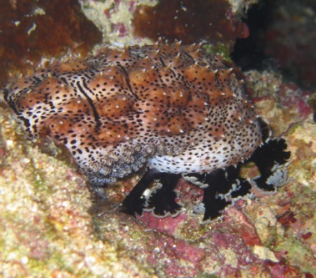
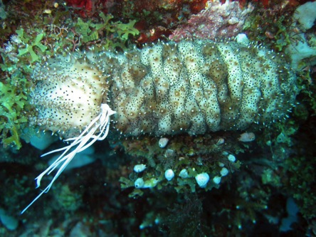
Variation
Pearsonothuria

Slide 19
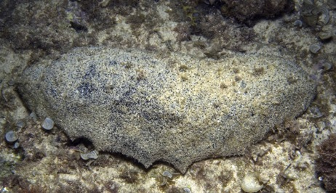
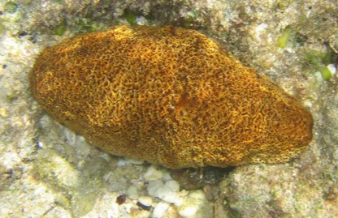
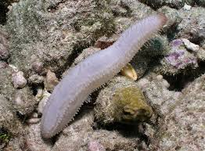
Variation
The structure varies only in species where Cuvierian tubules are not expelled.
Microthele
Actinopyga
Labidodemas

Slide 20
The Cuvierian tubules in Labidodemas
?????????????
Labidodemas americanum : Cuvierian tubules brown to greenish, numerous, short and thick.
(More information in Massin et al. 2004 )

Slide 21
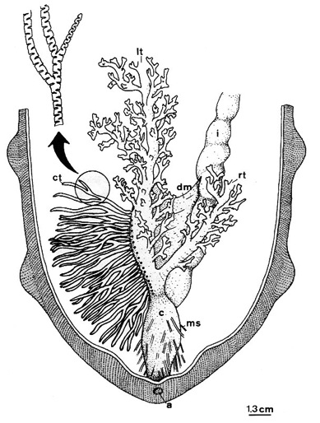
The So-called Cuvierian organs in Microthele
Holothuria (Microthele)
Some species of the subgenus Microthele possesses numerous branched tubules whose external surface shows alternative folds which are perpendicular to the long axis of the tubule.
The fine structure of the tubules closely resembles those of the Holothuria sp.. In contrast, basic behavioral differences occur as the tubules of Microthele sp. cannot elongated nor become sticky, or be expelled by individuals.
It is almost certain that these structure have no defensive role. Yet they are well developed organs that occur in great number in all observed individuals, but from the observation we made it is not possible to ascribe a possible function for these peculiar organs.
(More information in VandenSpiegel 1995)

Slide 22
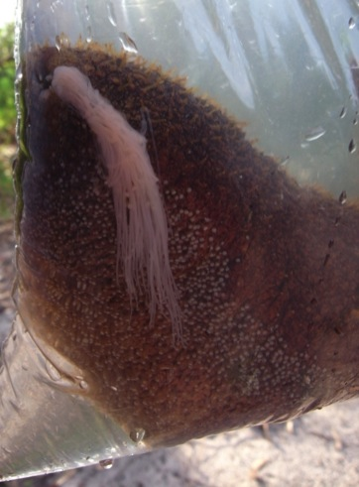
The So-called Cuvierian organs in Actinopyga
Genus Actinopyga
When observed in vivo, the Cuvierian organs in the genus Actinopyga consist of a reddish tuft of branched tubules (no more than 10 tubules per individual).
Actinopyga mauritiana

Slide 23
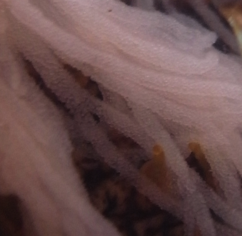
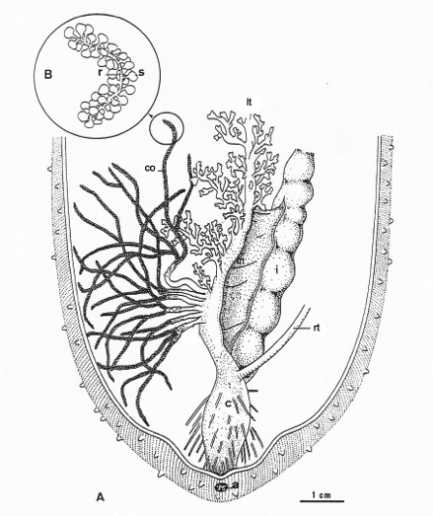
The So-called Cuvierian organs in Actinopyga
Genus Actinopyga
Tubules attach independently to the basal part of the left respiratory tree

Slide 24
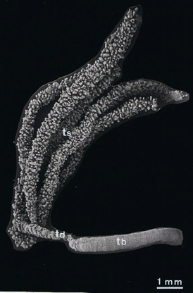
The So-called Cuvierian organs in Actinopyga
Two main parts can be distinguished along an actinopygid Cuvierian tubule
The tubule branches
The tubule trunk

Slide 25
The So-called Cuvierian organs in Actinopyga
The tubule trunk
The trunk is a smooth tube with a narrow lumen, it cannot be elongated and has the overall tissue organization of the respiratory tree.
The tubule branches
The tubule branches have no lumen and consists of a central rachis
and many peripheral spherules.
The structure of the rachis resembles that of the tubule trunk.
The spherule itself is made of an enlarged spherical central core containing vesicular cells

Slide 26
The So-called Cuvierian organs in Actinopyga
From the way actinopygid Cuvierian tubules attach and their overall histology they could be homologous to those of the other holothuroids but here again, it appears almost certain that these organs have no defensive role.
Additional information is required concerning the structure of the spherule’s vesicular cells an their changes - for example during growth and/or during the annual cycle of the species - before a possible function can be ascribe to these peculiar organs.
(More information in VandenSpiegel et al 1993)

Slide 27
Thank you for your attention

